Slide 1
a2zbasket

Slide 2
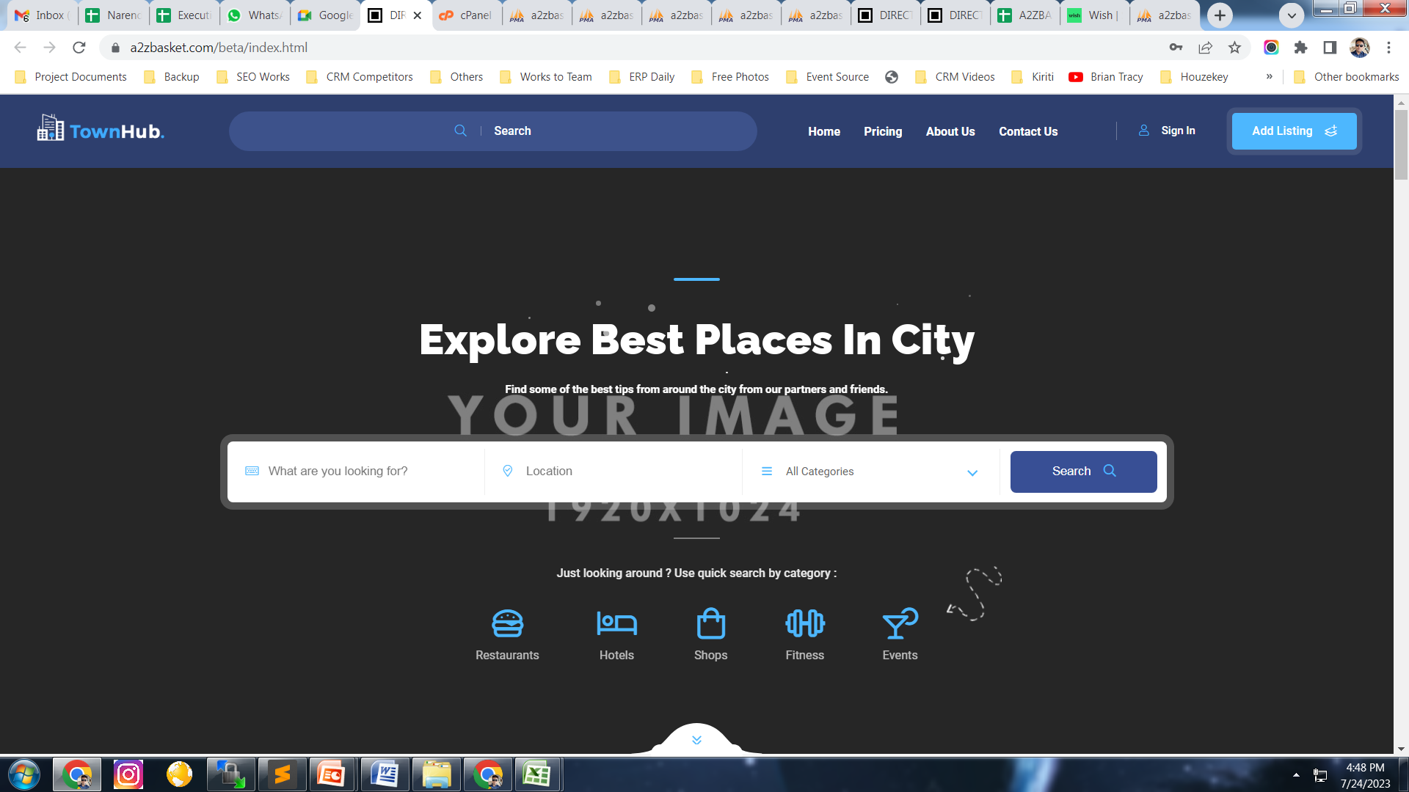
Location Name
Get all categories
Category keywords, product keywords, company keywords
Category Icons + Title >> On Click Should go to that particular category page

Slide 3
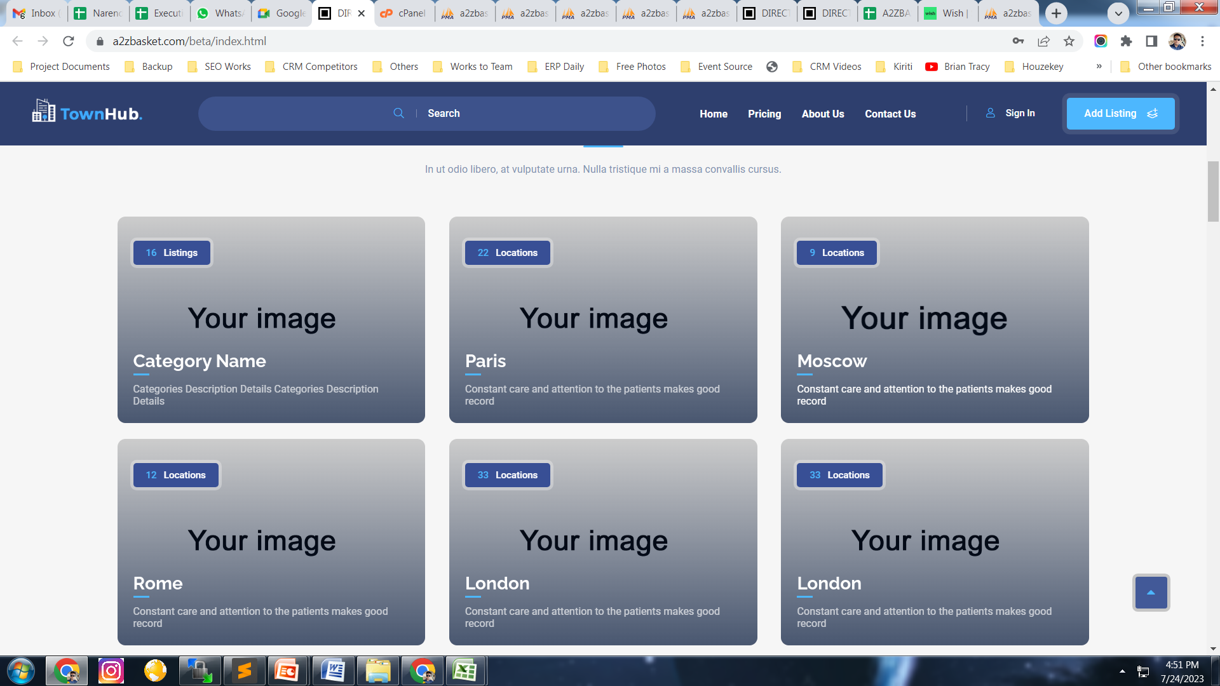
tranquil_categories

Slide 4
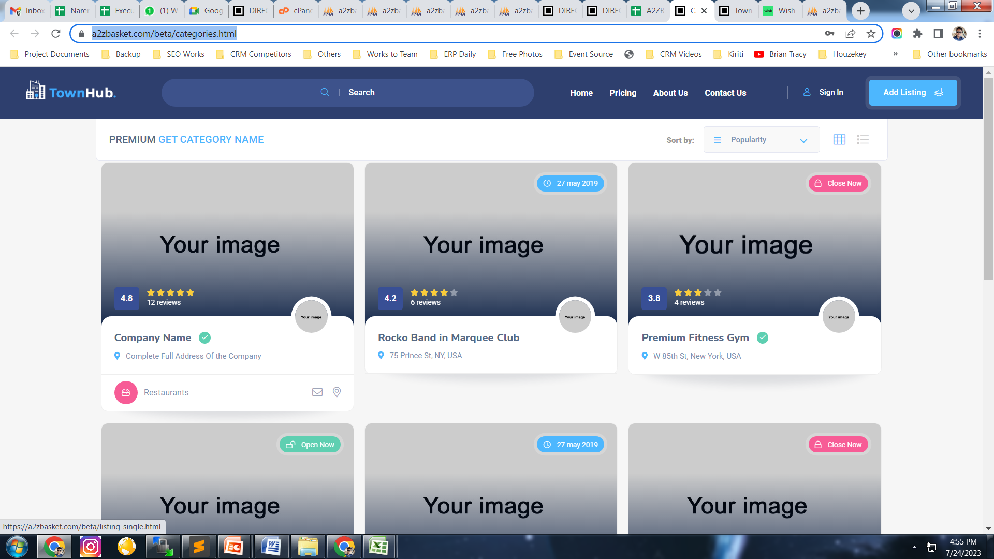
Click on Any Category >> tranquil_add_company >> based on >> category_id

Slide 5
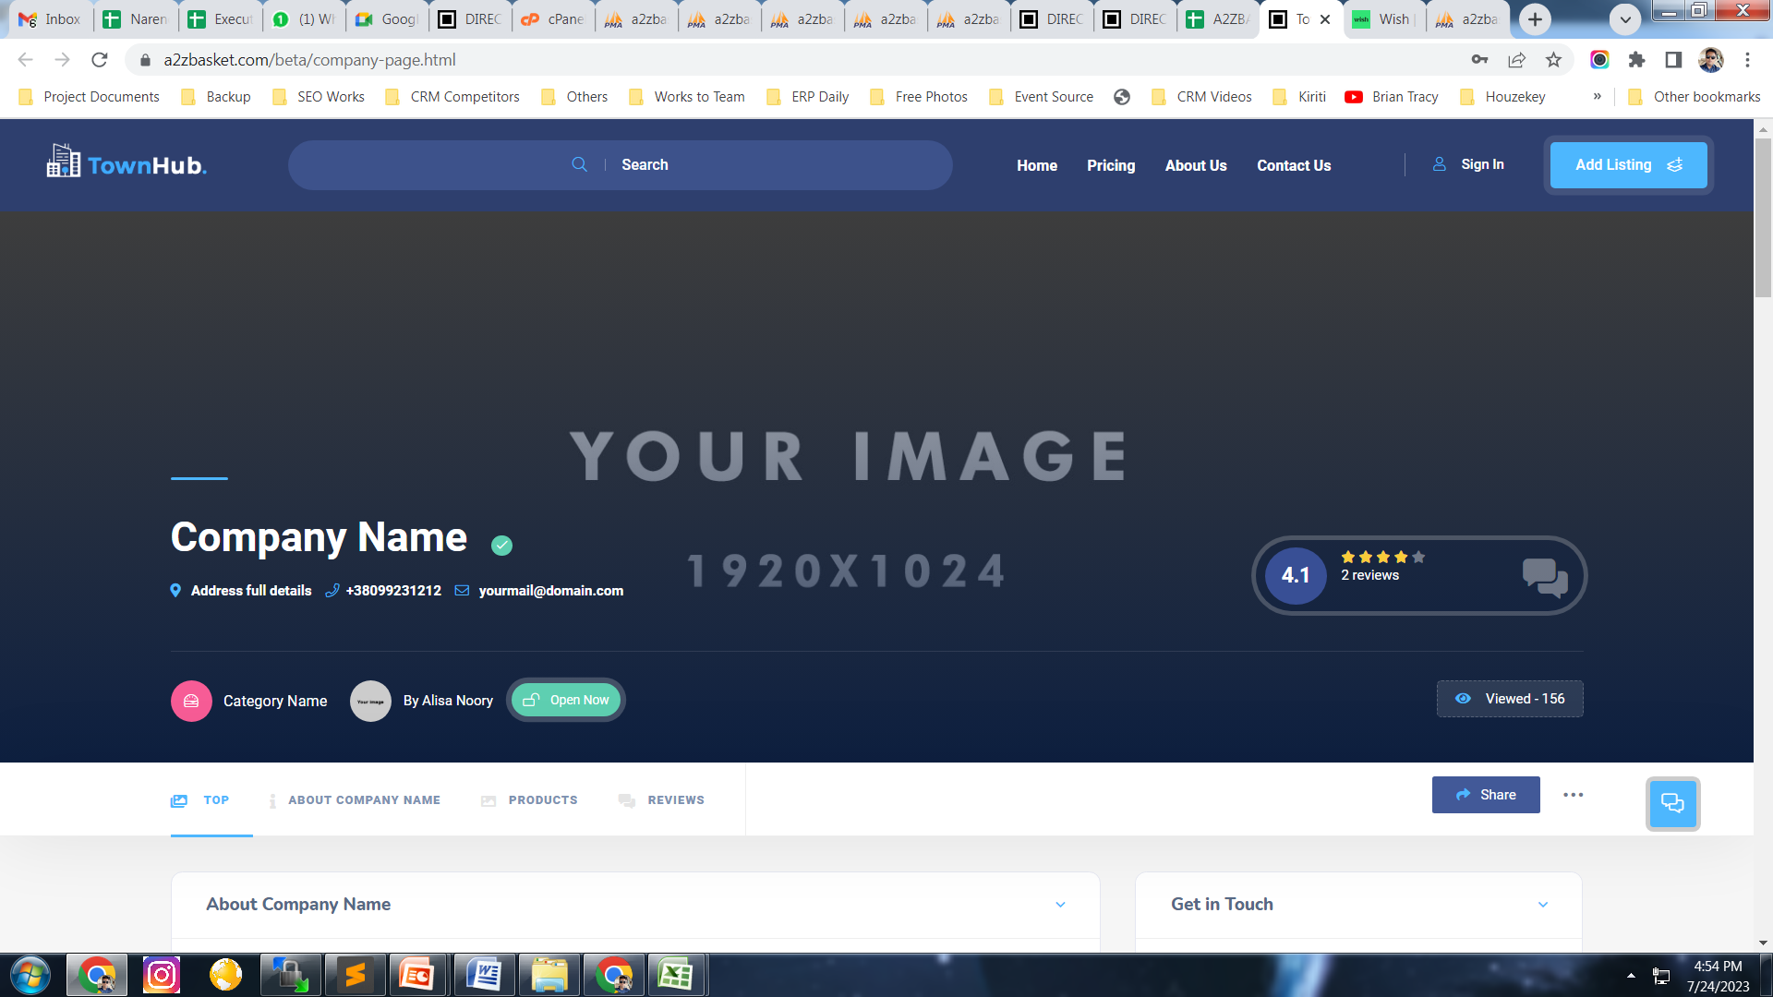
Click on Any Company
Info from>> tranquil_add_company &
tranquil_product_dtls

Slide 6
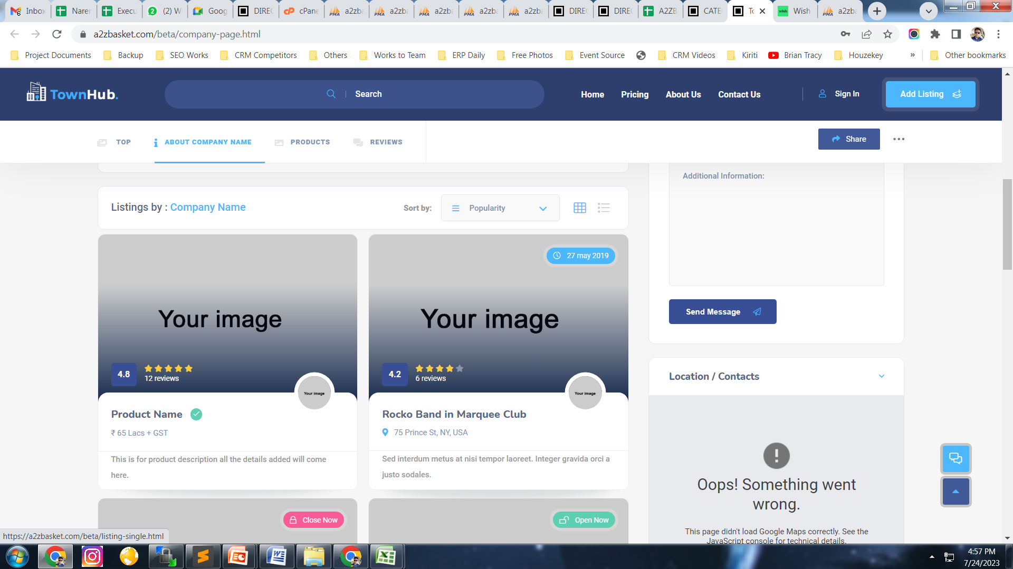

Slide 7
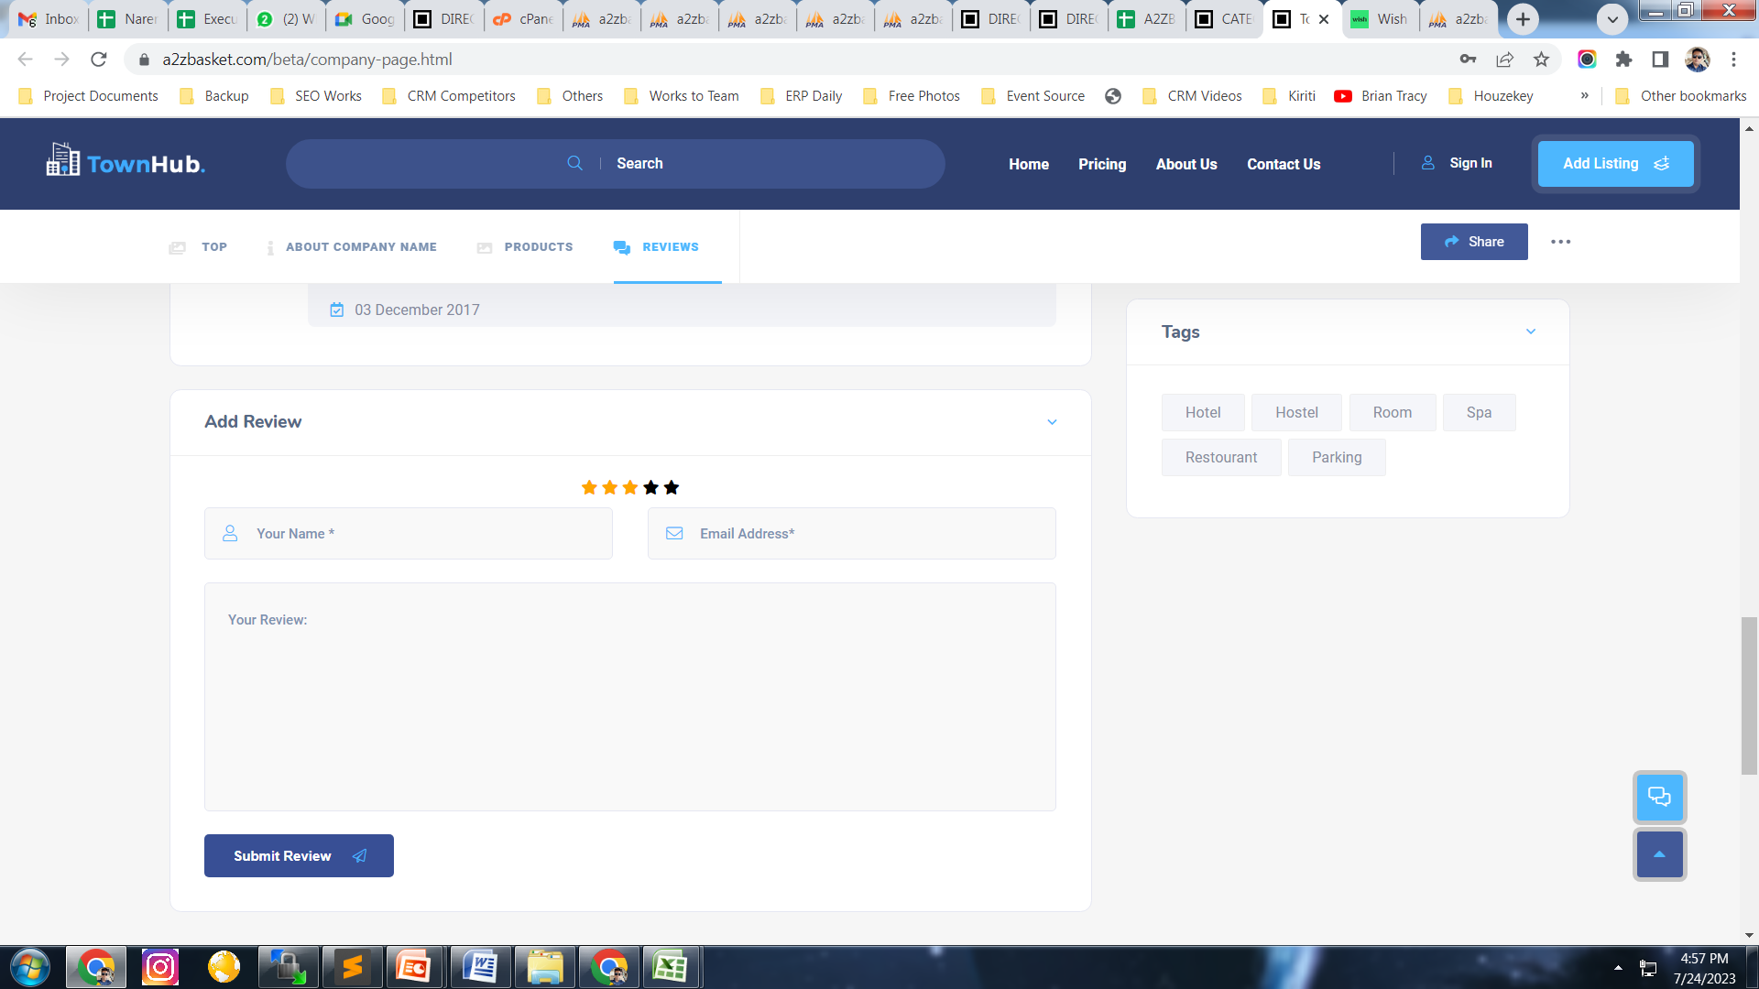
tranquil_company_reviews

Slide 8
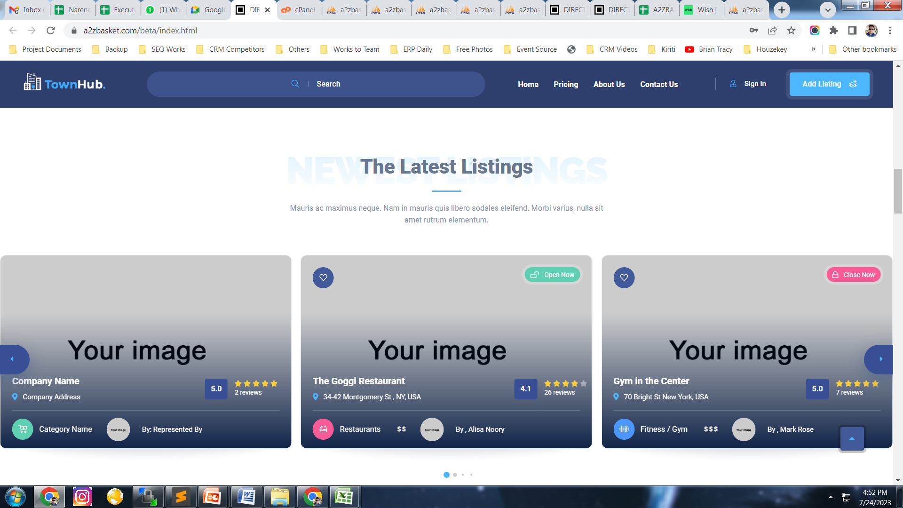
tranquil_add_company last 10 entries

Slide 9
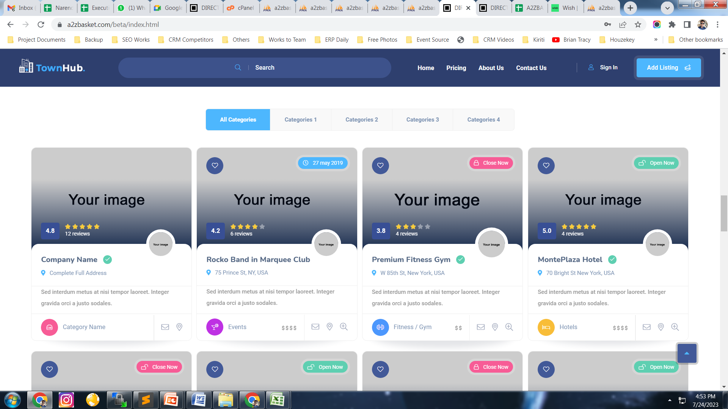
tranquil_add_company

